Slide 1

AMAZON SALES DATA ANALYSIS
-- YOGA NARASIMMAN S

Slide 2
Objective
The Significance Of Sales Management Has Grown Substantially Due To Escalating Competition And The Demand For Enhanced Distribution Methods Aimed At Cost Reduction And Profit Augmentation. In Contemporary Business Operations, Sales Management Stands As The Paramount Function Within Commercial Enterprises.

Slide 3
Problem Statement
Create A Comprehensive Report Through The Process Of Extracting, Transforming, And Loading (ETL) Of Data. This Report Will Encompass The Sales Trends Categorized By Year, Month, And Quarter. Furthermore, It Will Delve Into Data Relationships To Facilitate A Comprehensive Understanding And Thorough Analysis Of The Underlying Facts.

Slide 4
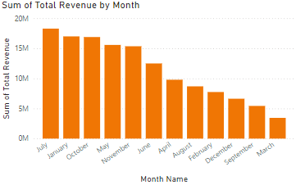
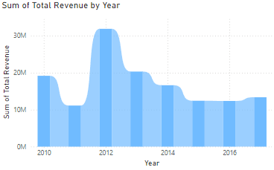
The Sales Trends Categorized By Month And Year

Slide 5
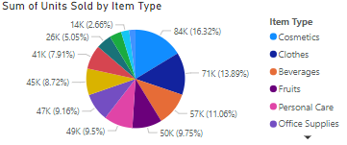
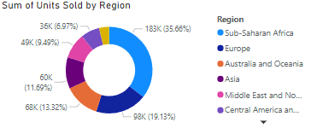
Total Units Sold By Item And Region

Slide 6
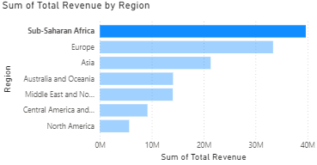
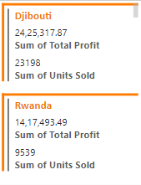
Total Revenue By Region

Slide 7
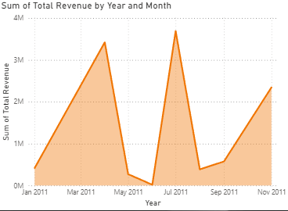
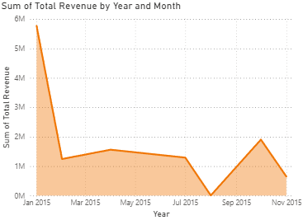
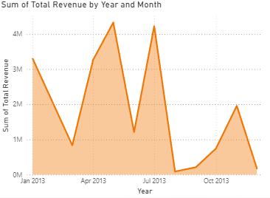
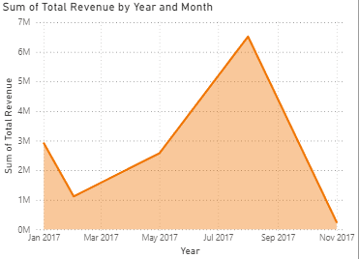
Total Revenue By Yearly-Month Wise
2011
2013
2015
2017

Slide 8

THANK YOU

